Slide 1
FLIP AND MATCH
Team 11

Slide 2
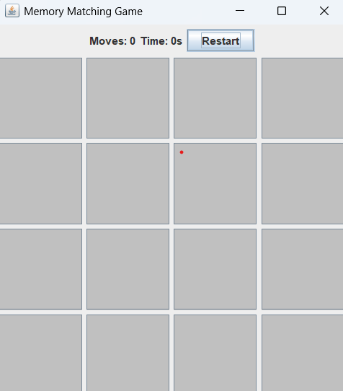
Introduction
Flip and Match is a fun and interactive memory card game.
The goal is to match pairs of cards by flipping them over.
The game keeps track of the number of moves and the time taken.
Built using Java Swing for GUI and event handling.
Demonstrates object-oriented programming and event-driven programming concepts.

Slide 3
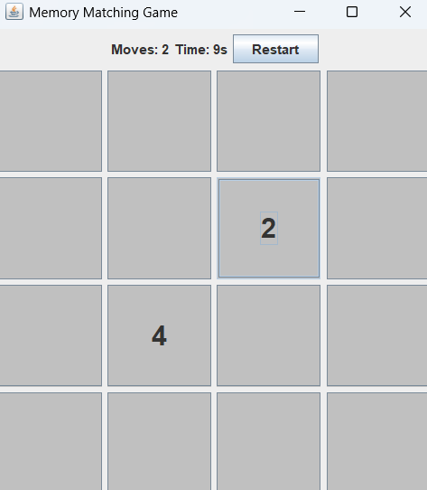
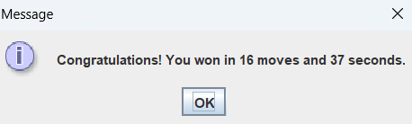


Features of the Game
Randomized Cards: Each game shuffle ensures a new challenge. Winning Condition: Displays a message when all pairs are matched. Restart Button: Allows replaying without restarting the application. Move Counter & Timer: Tracks player performance.

Slide 4
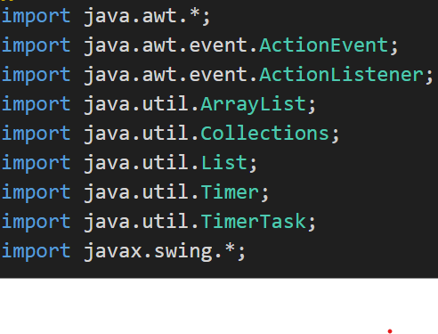
Core Concepts & Tools
Java & Swing: GUI framework and event handling.
OOP Principles: Encapsulation, classes, events.
Collections.shuffle(): Randomizes card values.
JFrame & JPanel: Creates the game window.
JButton & ActionListener: Handles card clicks.
TimerTask: Tracks game time.

Slide 5
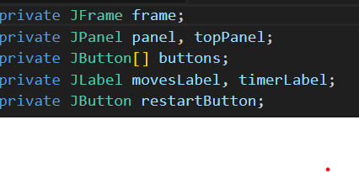
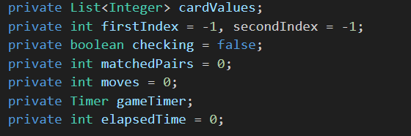
Code Explanation
GUI Components
frame: The main window.
panel: The 4x4 grid for buttons.
topPanel: Holds moves counter, timer, and restart button.
buttons: Stores 16 buttons, each acting as a card.
Game Logic Variables
cardValues: Stores pairs of numbers (1-8).
firstIndex, secondIndex: Track the selected buttons.
checking: Prevents multiple clicks while checking.
matchedPairs: Counts how many pairs are found.
moves: Keeps track of moves made.
gameTimer, elapsedTime: Manage time tracking.

Slide 6
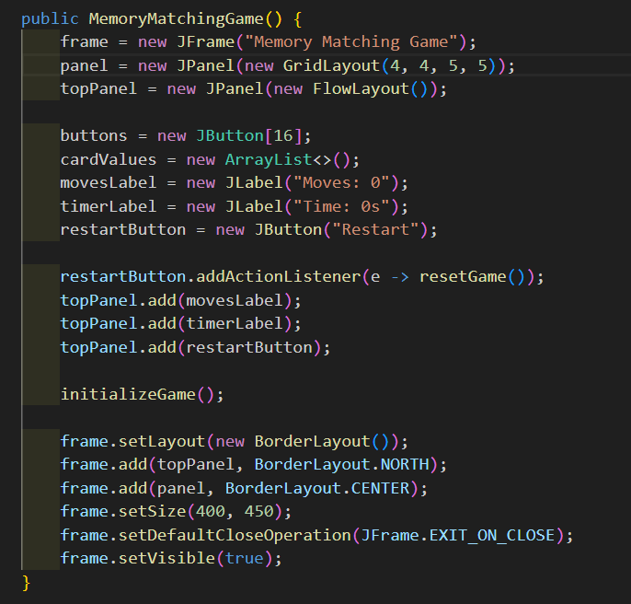
Constructor – MemoryMatchingGame()
Creates the game window (JFrame).
Sets up the panels (JPanel):
panel: Holds the 4x4 button grid.
topPanel: Holds moves, timer, and restart button.
Initializes game components:
buttons array (for cards).
cardValues list (to store numbers).
movesLabel and timerLabel (for move count and time).
restartButton with an action listener.
Calls initializeGame() to start the game.
Adds all components to the frame.

Slide 7
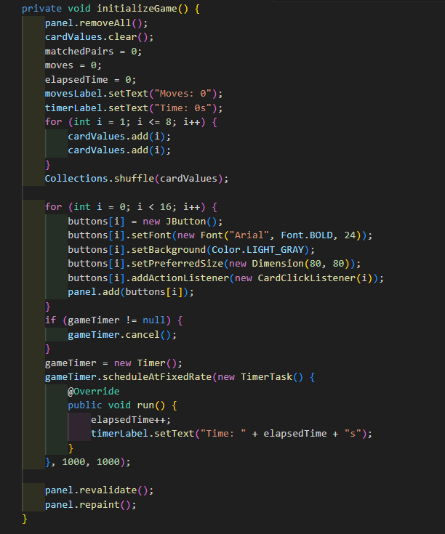
initializeGame() – Starts a New Game
Resets Game State: Clears the panel, resets move count, timer, and matched pairs.
Creates Card Pairs: Adds two copies of numbers (1-8) to cardValues and shuffles them.
Initializes Buttons: Creates 16 buttons, sets font, color, size, and assigns click listeners.
Starts Timer: Cancels the previous timer (if any) and starts a new one that updates timerLabel every second.
Refreshes UI: Calls revalidate() and repaint() to update the panel.

Slide 8
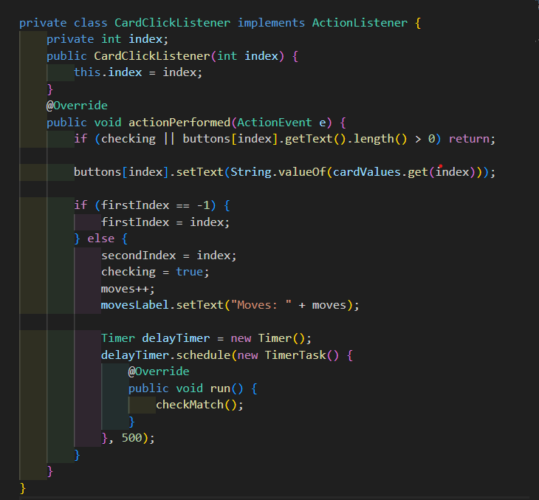
CardClickListener – Handles Card Clicks
Handles Button Clicks: Implements ActionListener to respond to card clicks.
Prevents Clicking Revealed Cards: Checks if the button already has text.
Reveals Card Value: Displays the number on the clicked button.
Tracks First and Second Clicks:
If it's the first selection, stores the index.
If it's the second, increments move count and starts match checking.
Delays Match Check: Uses a Timer to call checkMatch() after 500ms.

Slide 9
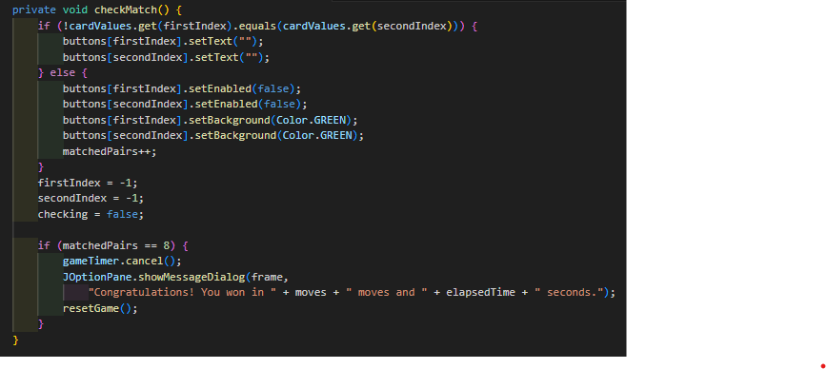
checkMatch() – Checks for a Match
Compares Selected Cards:
If they don't match, hides their values.
If they match, disables the buttons and highlights them in green.
Resets Selection: Resets firstIndex, secondIndex, and checking flag.
Checks for Win Condition:
If all pairs (8) are matched:
Stops the game timer.
Shows a message with the number of moves and elapsed time.
Calls resetGame() to restart the game.

Slide 10
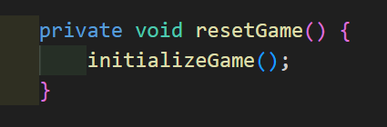

resetGame() – Restarts the Game
main() Method – Runs the Game

Slide 11
Conclusion
Memory Matching Game uses:
Java Swing for GUI
Event handling for user interaction
Game logic for matching pairs and tracking moves
Key Features:
Flip and match cards
Timer and move counter
Restart option

Slide 12
THANK YOU

